Slide 1
Design Algorithm and Analysis

Slide 2
Lets Get Greedy! & Go Backtracking

Slide 3
01
02
INTRODUCTION
Dijkstra Algorithm
03
04
INTRODUCTION
N Queen Algorithm
Greedy Method
A detail algorithm of the Dijkstra Shortest Path Problem
Backtracking Method
A detail algorithm of N Queen Problem

Slide 4
01.
Greedy Algorithm

Slide 5
Introduction
Greedy is an algorithmic paradigm that builds up a solution piece by piece, always choosing the next piece that offers the most obvious and immediate benefit. Greedy algorithms are used for optimization problems. An optimization problem can be solved using Greedy if the problem has the following property: At every step, we can make a choice that looks best at the moment, and we get the optimal solution of the complete problem.
For example, Kruskal’s Minimum Spanning Tree (MST):,Dijkstra’s Shortest Path , Prim’s Minimum Spanning Tree: can be solved using Greedy,

Slide 6
Examples
Kruskal’s Minimum Spanning Tree (MST)
Prim’s Minimum Spanning Tree
Dijkstra’s Shortest Path
In Kruskal’s algorithm, we create a
MST by picking edges one by one. The Greedy Choice is to pick the smallest weight edge
that doesn’t cause a cycle in the MST constructed so far.
In Prim’s algorithm also, we create a MST by picking edges one by one. We maintain two sets: a set of the vertices already included in
MST and the set of the vertices not yet included. The Greedy Choice is to pick the smallest weight edge that connects the two sets.
The shortest path tree is built up, edge by edge. We maintain two sets: a set of the vertices already included in the tree and the set of the vertices not yet included. The Greedy Choice is to pick the edge that connects the two sets and is on the smallest weight path from source to the set that contains not yet included vertices.

Slide 7

Lets discuss the examples in detail

Slide 8
Dijkstra’s Shortest Path
.02

Slide 9
Algorithm
The shortest path tree is built up, edge by edge.
We maintain two sets: a set of the vertices already included in the tree and the set of the vertices not yet included.
The Greedy Choice
is to pick the edge that connects the two sets and is on the smallest weight path from source
to the set that contains not yet included vertices.

Slide 10
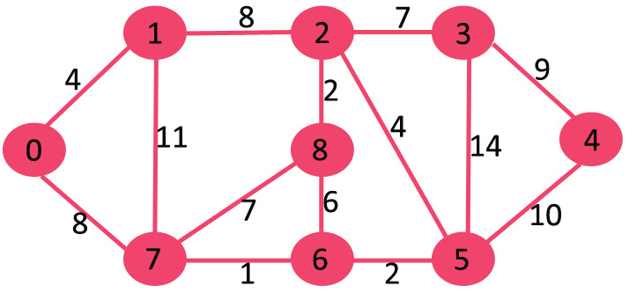
Below are the detailed steps used in Dijkstra’s algorithm to find the shortest path from a single source vertex to all other vertices in the given graph
Create a set sptSet (shortest path tree set) that keeps track of vertices included in shortest path tree, i.e., whose minimum distance from source is calculated and finalized. Initially, this set is empty
Assign a distance value to all vertices in the input graph. Initialize all distance values as INFINITE. Assign distance value as 0 for the source vertex so that it is picked first.
While sptSet doesn’t include all vertices ….a) Pick a vertex u which is not there in sptSet and has minimum distance value. ….b) Include u to sptSet. ….c) Update distance value of all adjacent vertices of u. To update the distance values, iterate through all adjacent vertices. For every adjacent vertex v, if sum of distance value of u (from source) and weight of edge u-v, is less than the distance value of v, then update the distance value of v

Slide 11

The set sptSet is initially empty and distances assigned to vertices are {0, INF, INF, INF, INF, INF, INF, INF} where INF indicates infinite. Now pick the vertex with minimum distance value. The vertex 0 is picked, include it in sptSet.
So sptSet becomes {0}. After including 0 to sptSet, update distance values of its adjacent vertices. Adjacent vertices of 0 are 1 and 7. The distance values of 1 and 7 are updated as 4 and 8. Following subgraph shows vertices and their distance values, only the vertices with finite distance values are shown. The vertices included in SPT are shown in green colour.

Slide 12
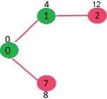
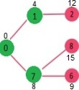
Pick the vertex with minimum distance value and not already included in SPT (not in sptSET). The vertex 1 is picked and added to sptSet. So sptSet now becomes {0, 1}. Update the distance values of adjacent vertices of 1. The distance value of vertex 2 becomes 12.
Pick the vertex with minimum distance value and not already included in SPT (not in sptSET). Vertex 7 is picked. So sptSet now becomes {0, 1, 7}. Update the distance values of adjacent vertices of 7. The distance value of vertex 6 and 8 becomes finite (15 and 9 respectively).

Slide 13
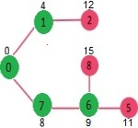
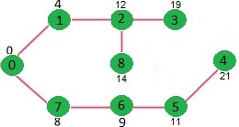
Pick the vertex with minimum distance value and not already included in SPT (not in sptSET). Vertex 6 is picked. So sptSet now becomes {0, 1, 7, 6}. Update the distance values of adjacent vertices of 6. The distance value of vertex 5 and 8 are updated
We repeat the above steps until sptSet does include all vertices of given graph. Finally, we get the following Shortest Path Tree (SPT)

Slide 14
Backtracking Algorithm
03.

Slide 15
Introduction
Backtracking is an algorithmic-technique for solving problems recursively by trying to build a solution incrementally, one piece at a time, removing those solutions that fail to satisfy the constraints of the problem at any point of time (by time, here, is referred to the time elapsed till reaching any level of the search tree).
For example, The Knight’s tour problem , Rat in a Maze , N Queen Problem can be solved using Backtracking,

Slide 16
Examples
The Knight’s tour problem
N Queen Problem
Backtracking works in an incremental way to attack problems. Typically, we start from
an empty solution vector and one by one add items (Meaning of item varies from problem to problem. In context of Knight’s tour problem, an item is a Knight’s move). When we add an item, we check if adding the current item violates the problem constraint, if it does then we remove the item and try other alternatives. If none of the alternatives work out then we
go to previous stage and remove the item added in the previous stage. If we reach the initial stage back then we say that no solution exists. If adding an item doesn’t violate constraints then we recursively add items one by one. If the solution vector becomes complete then we
print the solution.
The N Queen is the problem of placing N chess queens on an N×N chessboard so that no two queens attack each other. For example, following is a solution for 4 Queen problem. The expected output is a binary matrix which has 1s for the blocks where queens are placed. For example, following is the output matrix for above 4 queen solution.

Slide 17
N QUEEN PROBLEM
.04

Slide 18
Algorithm
The N Queen is the problem of placing N chess queens on an N×N chessboard so that no two queens attack each other
The expected output is a binary matrix which has 1s for the blocks where queens are placed
. For example, following is the output matrix for above 4 queen solution

Slide 19
Below are the detailed steps used in N Queen Problem
Generate all possible configurations of queens on board and print a configuration that satisfies the given constraints
while there are untried configurations
{
generate the next configuration
if queens don't attack in this configuration then
{
print this configuration;
}
}

Slide 20
Below are the detailed steps used in N Queen Problem
The idea is to place queens one by one in different columns, starting from the leftmost column. When we place a queen in a column, we check for clashes with already placed queens. In the current column, if we find a row for which there is no clash, we mark this row and column as part of the solution. If we do not find such a row due to clashes then we backtrack and return false
Start in the leftmost column
2) If all queens are placed return true
3) Try all rows in the current column.
Do following for every tried row.
a) If the queen can be placed safely in this row
then mark this [row, column] as part of the solution
and recursively check if placing queen here leads to a solution.
b) If placing the queen in [row, column] leads to
a solution then return true.
c) If placing queen doesn't lead to a solution
then unmark this [row, column] (Backtrack) and go
to step (a) to try other rows.
3) If all rows have been tried and nothing worked, return false to trigger backtracking.

Slide 21
OUR TEAM
Abhishek Kumar Suman
Prashant Chouhan

Slide 22
THANKS!

Slide 23


